Slide 1

Spotify Recommender Engine
Group 1: Amanda Lai, Chloe Lui, Daniel Gergov, and Ruben Wahjudi

Slide 2
Setup of the Original Model
Structure:
Used K-means clustering with 5 clusters
User enters favorite songs’ IDs
Finds most frequent cluster among users’ favorite songs
Get songs belonging to user’s favorite cluster and give first 5 song suggestions based on row #
Shortcomings:
Why 5 clusters? Did not use the elbow method to find optimal number of clusters
Did not handle outliers
Only uses K-means clustering and did not test out any other algorithms for improvements
Did not collect user feedback
Suggested songs based on row #

Slide 3
Data Exploration

Slide 4
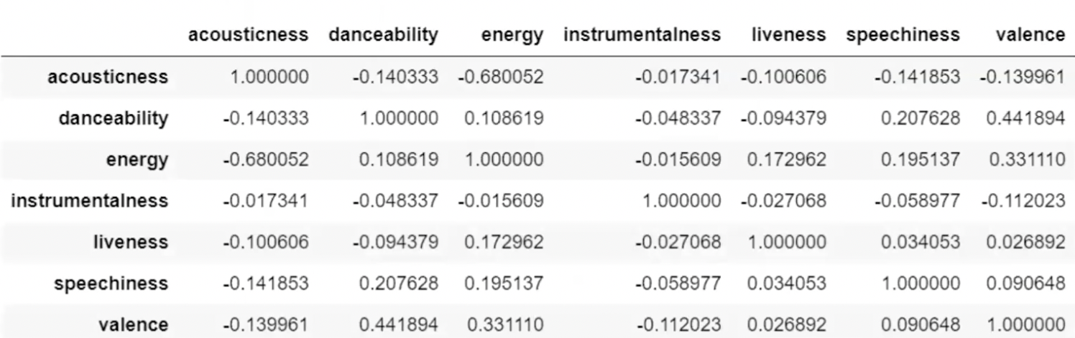
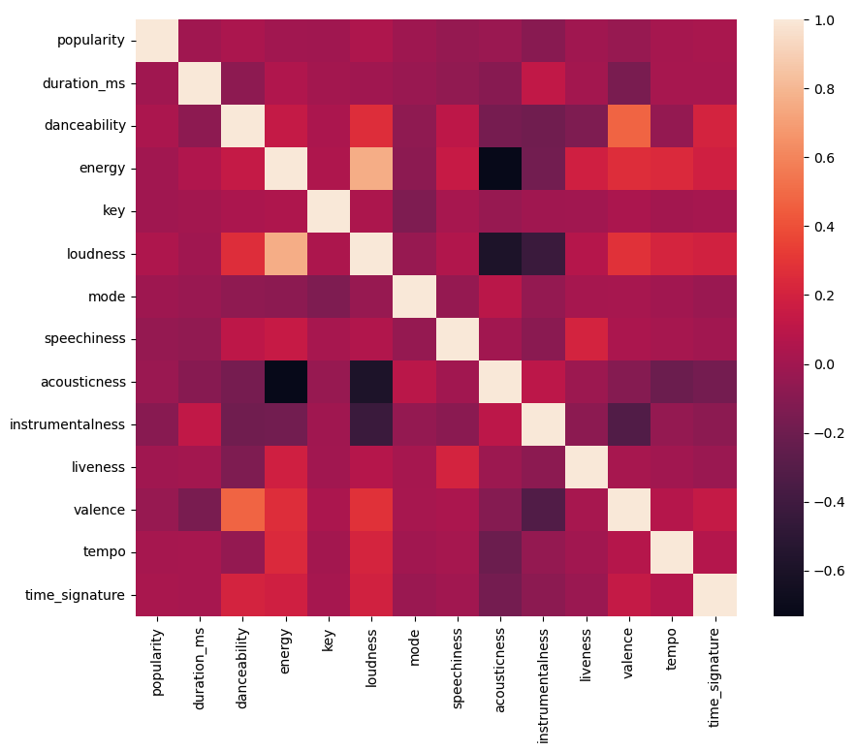
Correlations between variables
Strong correlations between
acousticness and energy/loudness
Some moderate correlations between loudness and instrumentalness loudness
Patterns reflected both in matrix and heatmap

Slide 5
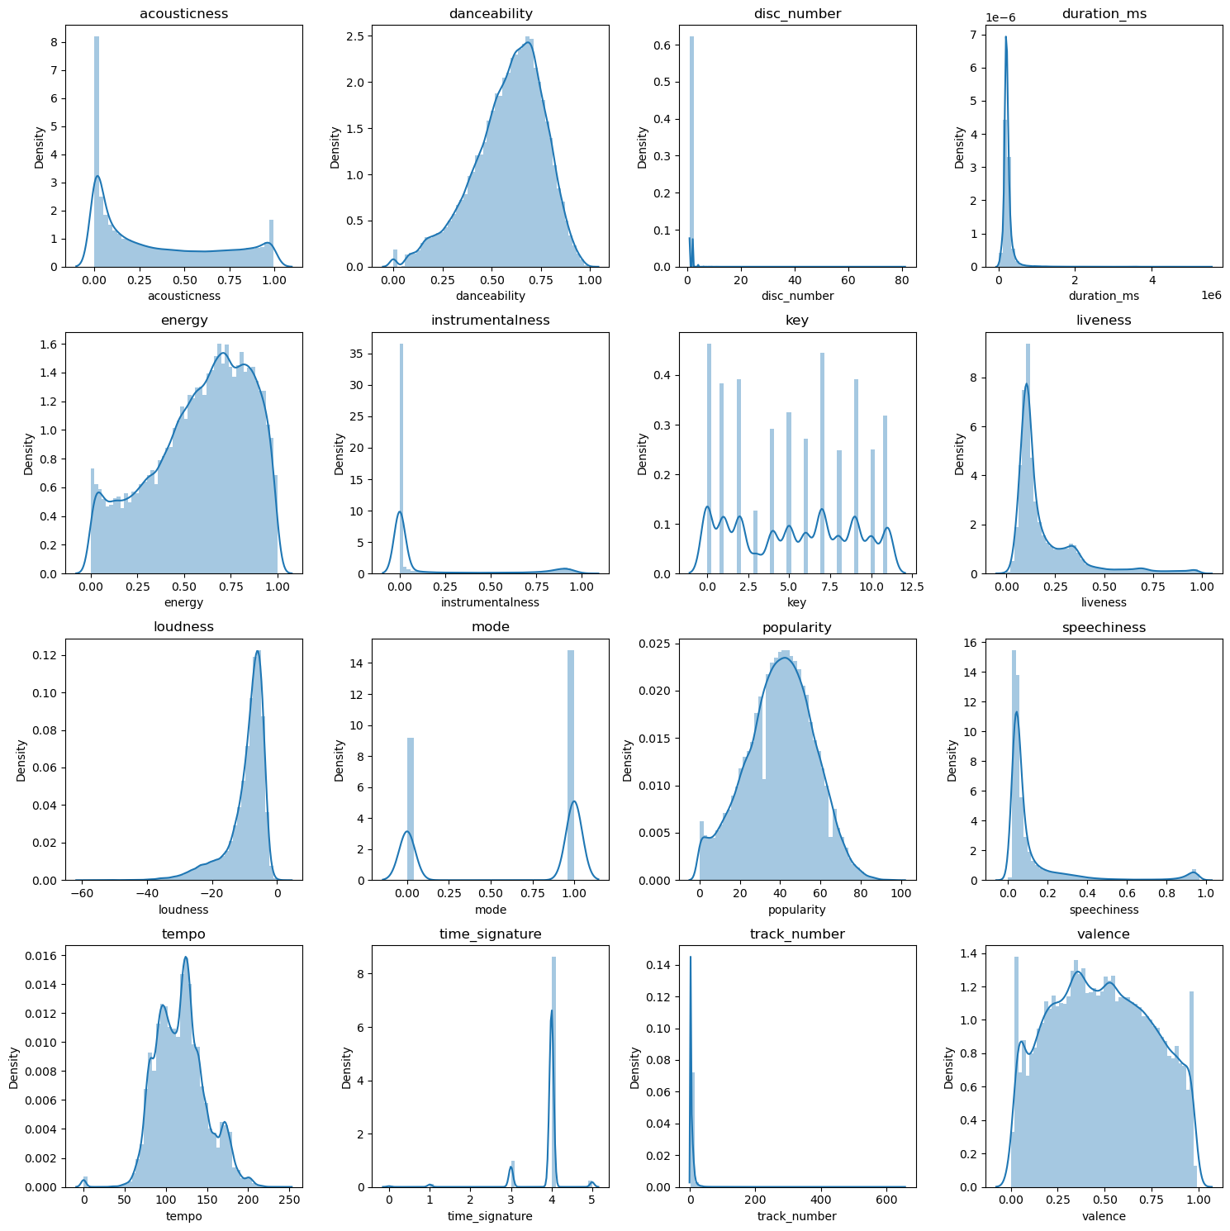
Distribution Graphs
Plotted the distribution of numerical columns to spot outliers
Liveness, duration_ms, and speechiness are all skewed right
Loudness and time_signature is skewed left

Slide 6
Enhancements & Benefits

Slide 7
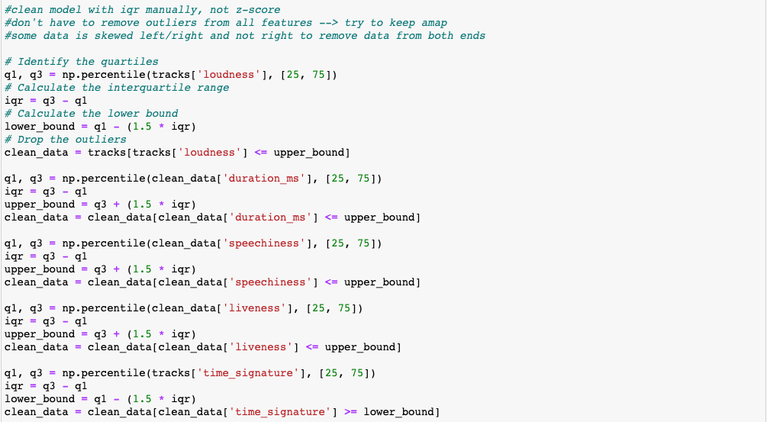
Removing outliers with IQR
Why this method is preferred:
Data is skewed
Z-score does not work well with skewed data
Manual removal for the skewed data (don’t remove data from both ends)
Allows for deletion of some outliers and not others to keep valuable data

Slide 8
Selecting features for clustering
# Select only necessary features for clustering
tracks = tracks_dftracks = tracks_df[["acousticness","danceability","energy","instrumentalness","liveness","speechiness","valence",'duration_ms','key','loudness','tempo','time_signature','popularity']]
Added:
Duration_ms
Key
Loudness
Tempo
Time_signature
popularity

Slide 9
Scaling Data Using PCA
Reduce dimensions while preserving variance in data
Helps with k-means’ “curse of dimensionality”
Improves run time

Slide 10
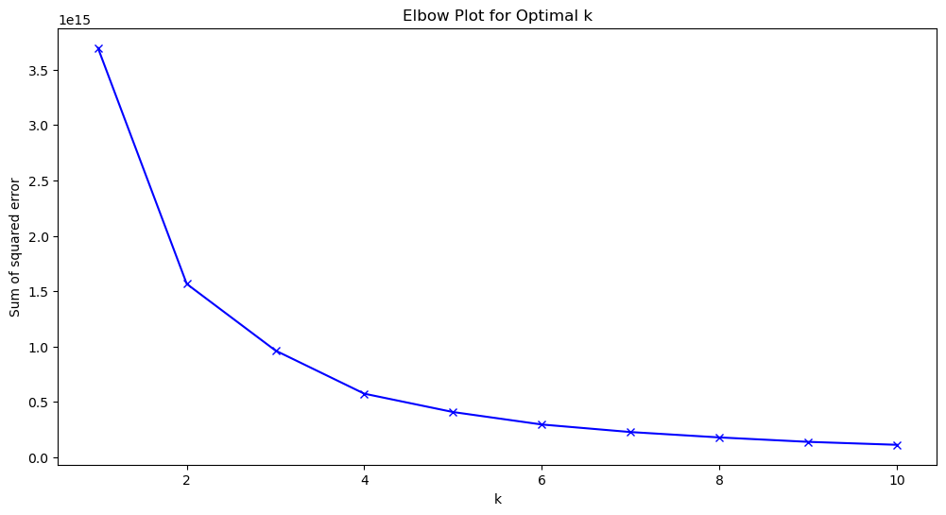
Elbow Method and Silhouette Score
We used the elbow method to determine the optimal number of clusters to use
Clusters chosen: 4
Silhouette score for 4 clusters was 0.53 with kmeans which is an acceptable fit
(A little computationally expensive)

Slide 11
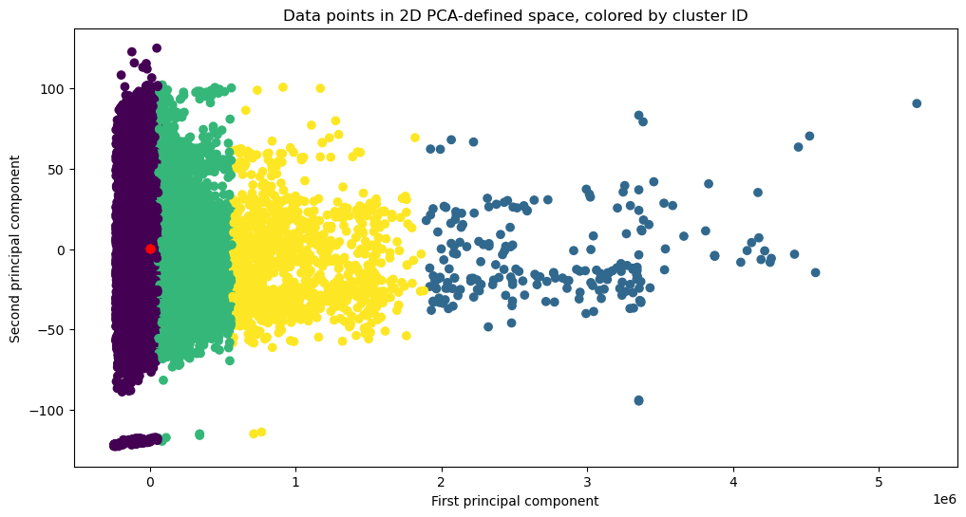
K-means clustering
Why?
Hierarchical Clustering
Computationally expensive
Runs slow
Dendrogram is hard to interpret
DBSCAN
Computationally expensive
Runs slow with large amounts of data

Slide 12
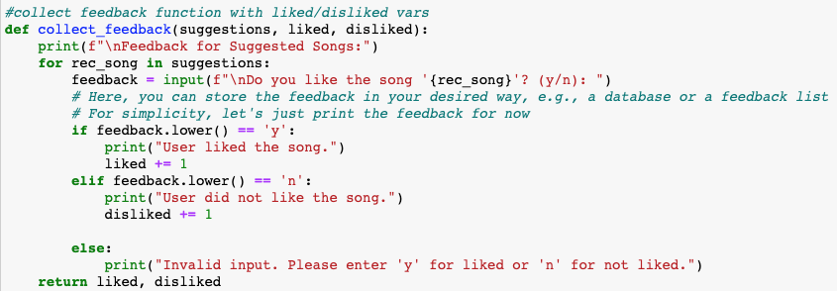
User Interaction
Created a collect_feedback function
Asks whether user likes each recommended song (yes/no) and returns the feedback for structure and simplicity
Data stored in int ‘liked’ and ‘disliked’
(yes += 1 for liked, no += 1 for disliked)

Slide 13
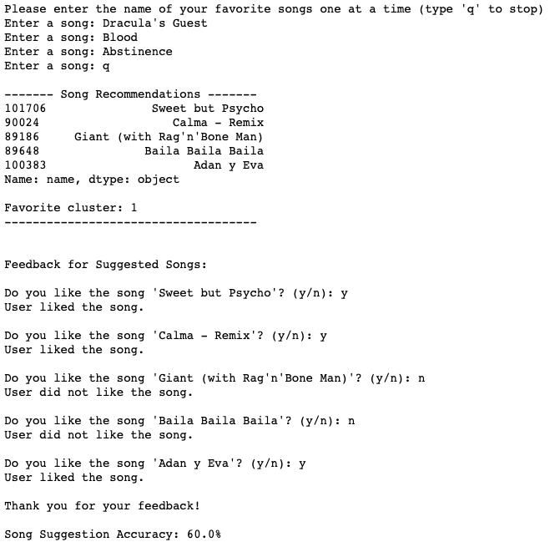
User Interaction
Changes made:
Song recommendations were sorted by popularity
Asks for user feedback on suggested songs (y/n)
Stores user feedback and calculates percentage of songs that were like by user

Slide 14
How user feedback can be incorporated into the model in future and its impact
Allows both user and model to see how well it is performing
User feedback acts as manual training and creates a new section of data
Can create a personal user database that stores user preferences
Ask user to rate the suggested songs’ features from 1-10, replace it in the data set, and scale other features based on the feedback

Slide 15
Future enhancements
Could create better user interaction
More detailed ratings (e.g. “On a scale from 1-10, how much did you like the song?”)
Why did they/did they not like the song?
Without bias, give song recommendations based on user’s personal information
Things like location, mood, weather, and age can have influence on a user’s music preference
Use genre classification to help identify clusters for the model to understand and make more accurate predictions/recommendations
Specifics of a song
Perhaps a user likes a certain word that shows up in their music’s lyrics a lot, or they like to listen to guitar over piano (each instrument can be given a number)
Improve runtime
Use PCA before K-means to reduce data dimensionality
Min-max scaling for data standardization

